Slide 1
Magic Bag
Source: http://nrich.maths.org/7061

Slide 2



Magic Bag
A magic bag contains some black and white balls, all of the same size, weight and shape. I put my hands in the bag and simultaneously and randomly pull out two balls. They are both the same colour and the magic bag tells me that the chance of this occurring was exactly 0.5.
The bag contains a given number of black balls.
Can you work out how many white ones there are?
What valid combinations of black and white balls are possible?
?
?
?
= 435
= ?
Notes:
1,3,6,10,15,21,28,36,45,55,66,78,91,105,120,136,153,171,190,210,231,253,276,300,325,351,378,406,435,465,496,528,561,595,630,666,703

Slide 3
Magic Bag - Answers
36 | 45 | 55
55 | 66 | 78
78 | 91 | 105
105 | 120 | 136
136 | 153 | 171
171 | 190 | 210
210 | 231 | 253
253 | 276 | 300
300 | 325 | 351
351 | 378 | 406
406 | 435 | 465
465 | 496 | 528
528 | 561 | 595
595 | 630 | 666

Slide 4
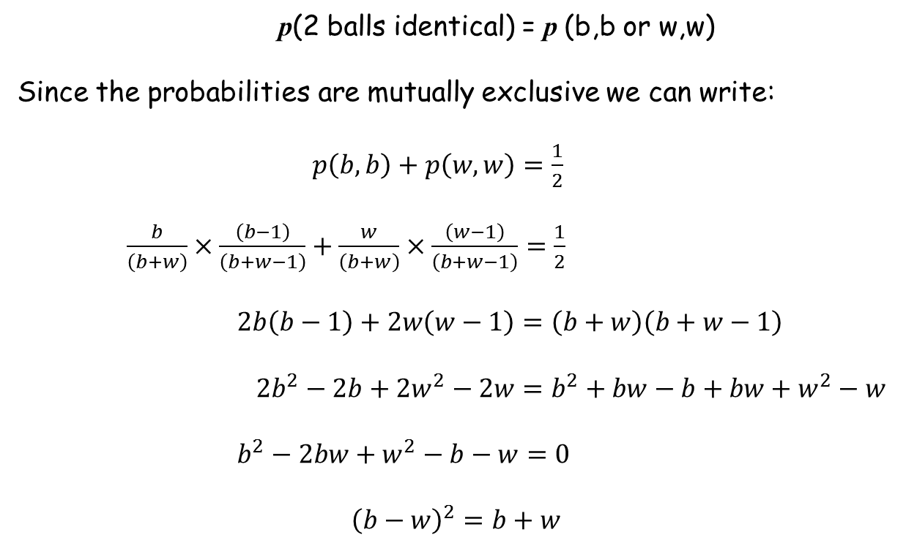
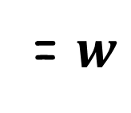
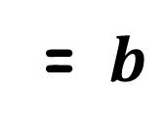
= $b$
= $w$
Let
p(2 balls identical) = p (b,b or w,w)
Since the probabilities are mutually exclusive we can write:
$p\left(b,b\right)+p\left(w,w\right)=\frac{1}{2}$
$\frac{b}{\left(b+w\right)}×\frac{\left(b−1\right)}{\left(b+w−1\right)}+\frac{w}{\left(b+w\right)}×\frac{\left(w−1\right)}{\left(b+w−1\right)}=\frac{1}{2}$
$2b\left(b−1\right)+2w\left(w−1\right)=\left(b+w\right)\left(b+w−1\right)$
$2b^{2}−2b+2w^{2}−2w=b^{2}+bw−b+bw+w^{2}−w$
$b^{2}−2bw+w^{2}−b−w=0$
$${\left(b−w\right)}^{2}=b+w$$

Slide 5
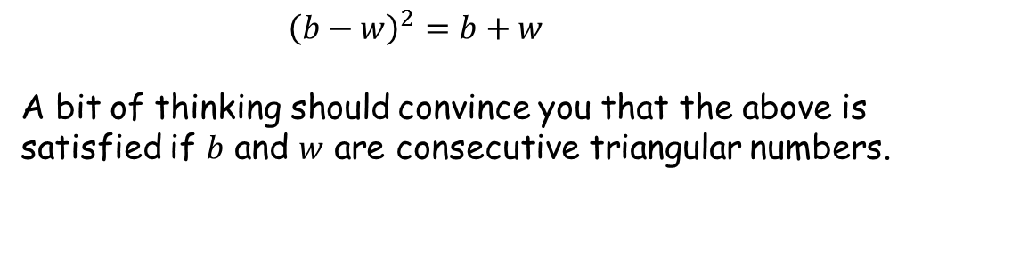
${\left(b−w\right)}^{2}=b+w$
A bit of thinking should convince you that the above is satisfied if $b$ and $w$ are consecutive triangular numbers.

Slide 6

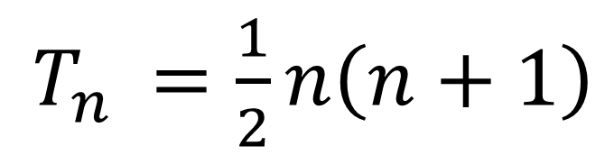

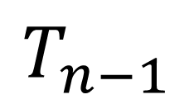
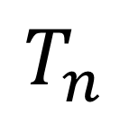

$$T_{n}$$
$$T_{n−1}$$
$$n$$
$$n$$
$$n−1$$
$T_{n }=\frac{1}{2}n\left(n+1\right)$

Slide 7
Subtracting consecutive triangular numbers
$$n$$

Slide 8
Subtracting consecutive triangular numbers
$$n$$

Slide 9

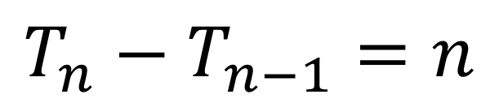
Subtracting consecutive triangular numbers
$$T_{n}−T_{n−1}=n$$
$$n$$

Slide 10
Adding consecutive triangular numbers
$$n$$

Slide 11
Adding consecutive triangular numbers
$$n$$

Slide 12
Adding consecutive triangular numbers
$$n$$

Slide 13
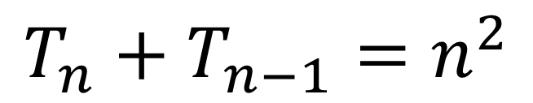
Adding consecutive triangular numbers
$$n$$
$$T_{n}+T_{n−1}=n^{2}$$
$$n$$

Slide 14
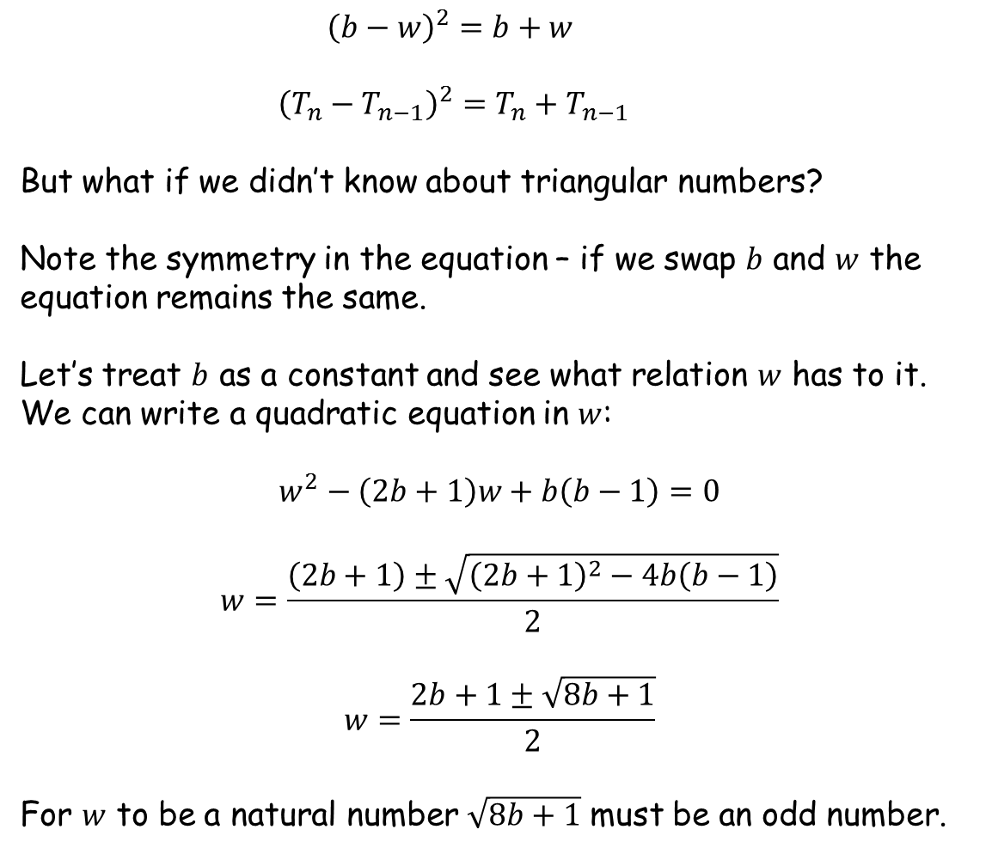
${\left(b−w\right)}^{2}=b+w$
${\left(T_{n}−T_{n−1}\right)}^{2}=T_{n}+T_{n−1}$
But what if we didn’t know about triangular numbers?
Note the symmetry in the equation – if we swap $b$ and $w$ the equation remains the same.
Let’s treat $b$ as a constant and see what relation $w$ has to it. We can write a quadratic equation in $w$:
$$w^{2}−\left(2b+1\right)w+b\left(b−1\right)=0$$
$$w=\frac{\left(2b+1\right)±\sqrt{{\left(2b+1\right)}^{2}−4b\left(b−1\right)}}{2}$$
$$w=\frac{2b+1±\sqrt{8b+1}}{2}$$
For $w$ to be a natural number $\sqrt{8b+1}$ must be an odd number.
Another clue about triangular numbers!

Slide 15
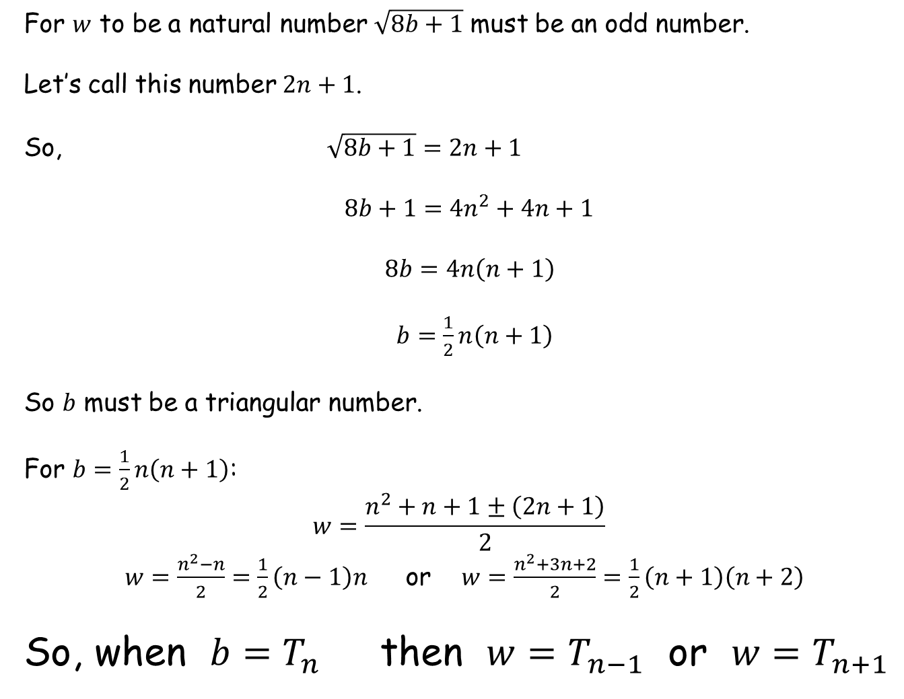
For $w$ to be a natural number $\sqrt{8b+1}$ must be an odd number.
Let’s call this number $2n+1$.
So, $\sqrt{8b+1}=2n+1$
$8b+1=4n^{2}+4n+1$
$8b=4n\left(n+1\right)$
$b=\frac{1}{2}n\left(n+1\right)$
So $b$ must be a triangular number.
For $b=\frac{1}{2}n\left(n+1\right)$:
$$w=\frac{n^{2}+n+1±\left(2n+1\right)}{2}$$
$w=\frac{n^{2}−n}{2}=\frac{1}{2}\left(n−1\right)n$ or $w=\frac{n^{2}+3n+2}{2}=\frac{1}{2}\left(n+1\right)\left(n+2\right)$
So, when $b=T_{n}$ then $w=T_{n−1}$ or $w=T_{n+1}$

Slide 17
Note to Teacher
There are two answers
the number of black balls is a triangular number and the number of white balls are the previous and next triangular numbers
The number of black balls are alternate triangular numbers so students should get some answers the same
Some students may spot the pattern of numbers from the lower three – but they still need to prove it!

Slide 18
Resources

Slide 19
Magic Bag
A magic bag contains some black and white balls, all of the same size, weight and shape. I put my hands in the bag and simultaneously and randomly pull out two balls. They are both the same colour and the magic bag tells me that the chance of this occurring was exactly 0.5.
The bag contains a given number of black balls.
Can you work out how many white ones there are?
What valid combinations of black and white balls are possible?
?
?
?
= 45
= ?
SIC_10
Notes:
1,3,6,10,15,21,28,36,45,55,66,78,91,105,120,136,153,171,190,210,231,253,276,300,325,351,378,406,435,465,496,528,561,595,630,666,703

Slide 20
Magic Bag
A magic bag contains some black and white balls, all of the same size, weight and shape. I put my hands in the bag and simultaneously and randomly pull out two balls. They are both the same colour and the magic bag tells me that the chance of this occurring was exactly 0.5.
The bag contains a given number of black balls.
Can you work out how many white ones there are?
What valid combinations of black and white balls are possible?
?
?
?
= 66
= ?
SIC_10
Notes:
1,3,6,10,15,21,28,36,45,55,66,78,91,105,120,136,153,171,190,210,231,253,276,300,325,351,378,406,435,465,496,528,561,595,630,666,703

Slide 21
Magic Bag
A magic bag contains some black and white balls, all of the same size, weight and shape. I put my hands in the bag and simultaneously and randomly pull out two balls. They are both the same colour and the magic bag tells me that the chance of this occurring was exactly 0.5.
The bag contains a given number of black balls.
Can you work out how many white ones there are?
What valid combinations of black and white balls are possible?
?
?
?
= 91
= ?
SIC_10
Notes:
1,3,6,10,15,21,28,36,45,55,66,78,91,105,120,136,153,171,190,210,231,253,276,300,325,351,378,406,435,465,496,528,561,595,630,666,703

Slide 22
Magic Bag
A magic bag contains some black and white balls, all of the same size, weight and shape. I put my hands in the bag and simultaneously and randomly pull out two balls. They are both the same colour and the magic bag tells me that the chance of this occurring was exactly 0.5.
The bag contains a given number of black balls.
Can you work out how many white ones there are?
What valid combinations of black and white balls are possible?
?
?
?
= 120
= ?
SIC_10
Notes:
1,3,6,10,15,21,28,36,45,55,66,78,91,105,120,136,153,171,190,210,231,253,276,300,325,351,378,406,435,465,496,528,561,595,630,666,703

Slide 23
Magic Bag
A magic bag contains some black and white balls, all of the same size, weight and shape. I put my hands in the bag and simultaneously and randomly pull out two balls. They are both the same colour and the magic bag tells me that the chance of this occurring was exactly 0.5.
The bag contains a given number of black balls.
Can you work out how many white ones there are?
What valid combinations of black and white balls are possible?
?
?
?
= 153
= ?
SIC_10
Notes:
1,3,6,10,15,21,28,36,45,55,66,78,91,105,120,136,153,171,190,210,231,253,276,300,325,351,378,406,435,465,496,528,561,595,630,666,703

Slide 24
Magic Bag
A magic bag contains some black and white balls, all of the same size, weight and shape. I put my hands in the bag and simultaneously and randomly pull out two balls. They are both the same colour and the magic bag tells me that the chance of this occurring was exactly 0.5.
The bag contains a given number of black balls.
Can you work out how many white ones there are?
What valid combinations of black and white balls are possible?
?
?
?
= 190
= ?
SIC_10
Notes:
1,3,6,10,15,21,28,36,45,55,66,78,91,105,120,136,153,171,190,210,231,253,276,300,325,351,378,406,435,465,496,528,561,595,630,666,703

Slide 25
Magic Bag
A magic bag contains some black and white balls, all of the same size, weight and shape. I put my hands in the bag and simultaneously and randomly pull out two balls. They are both the same colour and the magic bag tells me that the chance of this occurring was exactly 0.5.
The bag contains a given number of black balls.
Can you work out how many white ones there are?
What valid combinations of black and white balls are possible?
?
?
?
= 231
= ?
SIC_10
Notes:
1,3,6,10,15,21,28,36,45,55,66,78,91,105,120,136,153,171,190,210,231,253,276,300,325,351,378,406,435,465,496,528,561,595,630,666,703

Slide 26
Magic Bag
A magic bag contains some black and white balls, all of the same size, weight and shape. I put my hands in the bag and simultaneously and randomly pull out two balls. They are both the same colour and the magic bag tells me that the chance of this occurring was exactly 0.5.
The bag contains a given number of black balls.
Can you work out how many white ones there are?
What valid combinations of black and white balls are possible?
?
?
?
= 276
= ?
SIC_10
Notes:
1,3,6,10,15,21,28,36,45,55,66,78,91,105,120,136,153,171,190,210,231,253,276,300,325,351,378,406,435,465,496,528,561,595,630,666,703

Slide 27
Magic Bag
A magic bag contains some black and white balls, all of the same size, weight and shape. I put my hands in the bag and simultaneously and randomly pull out two balls. They are both the same colour and the magic bag tells me that the chance of this occurring was exactly 0.5.
The bag contains a given number of black balls.
Can you work out how many white ones there are?
What valid combinations of black and white balls are possible?
?
?
?
= 325
= ?
SIC_10
Notes:
1,3,6,10,15,21,28,36,45,55,66,78,91,105,120,136,153,171,190,210,231,253,276,300,325,351,378,406,435,465,496,528,561,595,630,666,703

Slide 28
Magic Bag
A magic bag contains some black and white balls, all of the same size, weight and shape. I put my hands in the bag and simultaneously and randomly pull out two balls. They are both the same colour and the magic bag tells me that the chance of this occurring was exactly 0.5.
The bag contains a given number of black balls.
Can you work out how many white ones there are?
What valid combinations of black and white balls are possible?
?
?
?
= 378
= ?
SIC_10
Notes:
1,3,6,10,15,21,28,36,45,55,66,78,91,105,120,136,153,171,190,210,231,253,276,300,325,351,378,406,435,465,496,528,561,595,630,666,703

Slide 29
Magic Bag
A magic bag contains some black and white balls, all of the same size, weight and shape. I put my hands in the bag and simultaneously and randomly pull out two balls. They are both the same colour and the magic bag tells me that the chance of this occurring was exactly 0.5.
The bag contains a given number of black balls.
Can you work out how many white ones there are?
What valid combinations of black and white balls are possible?
?
?
?
= 435
= ?
SIC_10
Notes:
1,3,6,10,15,21,28,36,45,55,66,78,91,105,120,136,153,171,190,210,231,253,276,300,325,351,378,406,435,465,496,528,561,595,630,666,703

Slide 30
Magic Bag
A magic bag contains some black and white balls, all of the same size, weight and shape. I put my hands in the bag and simultaneously and randomly pull out two balls. They are both the same colour and the magic bag tells me that the chance of this occurring was exactly 0.5.
The bag contains a given number of black balls.
Can you work out how many white ones there are?
What valid combinations of black and white balls are possible?
?
?
?
= 496
= ?
SIC_10
Notes:
1,3,6,10,15,21,28,36,45,55,66,78,91,105,120,136,153,171,190,210,231,253,276,300,325,351,378,406,435,465,496,528,561,595,630,666,703

Slide 31
Magic Bag
A magic bag contains some black and white balls, all of the same size, weight and shape. I put my hands in the bag and simultaneously and randomly pull out two balls. They are both the same colour and the magic bag tells me that the chance of this occurring was exactly 0.5.
The bag contains a given number of black balls.
Can you work out how many white ones there are?
What valid combinations of black and white balls are possible?
?
?
?
= 561
= ?
SIC_10
Notes:
1,3,6,10,15,21,28,36,45,55,66,78,91,105,120,136,153,171,190,210,231,253,276,300,325,351,378,406,435,465,496,528,561,595,630,666,703

Slide 32
Magic Bag
A magic bag contains some black and white balls, all of the same size, weight and shape. I put my hands in the bag and simultaneously and randomly pull out two balls. They are both the same colour and the magic bag tells me that the chance of this occurring was exactly 0.5.
The bag contains a given number of black balls.
Can you work out how many white ones there are?
What valid combinations of black and white balls are possible?
?
?
?
= 630
= ?
SIC_10
Notes:
1,3,6,10,15,21,28,36,45,55,66,78,91,105,120,136,153,171,190,210,231,253,276,300,325,351,378,406,435,465,496,528,561,595,630,666,703

